Slide 2
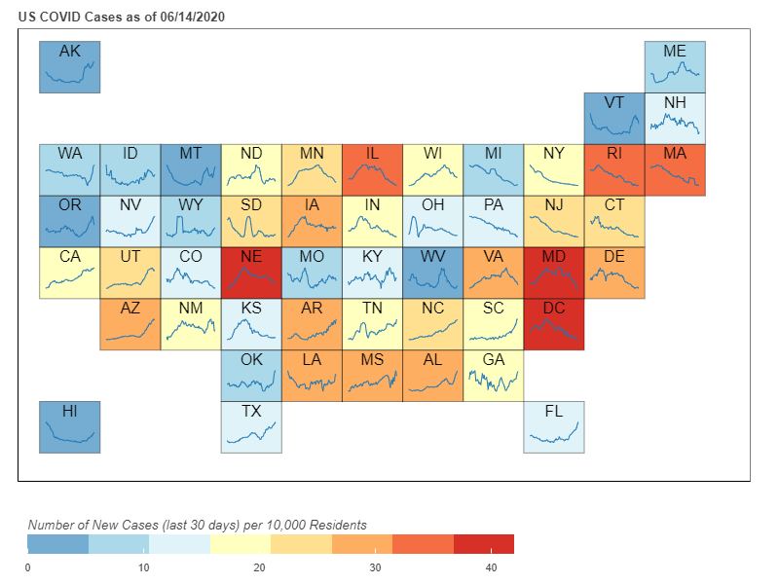
Trendline = New Cases

Slide 3

Trendline = Num Hospitalized

Slide 4

Trendline = New Deaths

Slide 5

Trendline = Test Positive %

